Slide 1

Cybersecurity
Awareness
Tips To Protect You And Your Data
CONTENT BY
PRESENTED BY
Your info and/or company logo here
www.treetopsecurity.com
From the makers of Peak. The only comprehensive and affordable cybersecurity platform for small businesses.
Notes:
We’ve added speaker notes! The speaker notes are not meant to be read line-by-line!!! Similarly, don’t read everything on the slides word-for-word. Instead, engage with your audience. Tell stories to help back up the material. Watch your attendees to determine if you are losing them or if you need to spend more time on a topic. Ask questions or randomly poll them about various material. Even something as simple as using audience members names in theoretical examples is a great way to pull them back in. Most importantly, have fun!

Slide 2
Cybersecurity
Awareness
Tips To Protect You And Your Data
Example
CONTENT BY
PRESENTED BY
DALLAS HASELHORST FOUNDER/PRINCIPAL, TREETOP SECURITY GSE #231, MSISE, CISSP, SANS/GIAC(X10)
www.treetopsecurity.com
From the makers of Peak. The only comprehensive and affordable cybersecurity platform for small businesses.
Notes:
We’ve added speaker notes! The speaker notes are not meant to be read line-by-line!!! Similarly, don’t read everything on the slides word-for-word. Instead, engage with your audience. Tell stories to help back up the material. Watch your attendees to determine if you are losing them or if you need to spend more time on a topic. Ask questions or randomly poll them about various material. Even something as simple as using audience members names in theoretical examples is a great way to pull them back in. Most importantly, have fun!

Slide 3

# whoami
Tell the audience about yourself
Where you work
Background
Education
Work experience
Why you are doing this
Why you like volunteering
Notes:
This is a chance for you to tell the audience a little bit about yourself. Include information about how you relate to the subject such as why you enjoy helping people avoid scams, why you're qualified to talk about cybersecurity, etc. Maybe it’s because you were scammed yourself so you have some additional insight. Personal stories can go a long way to helping attendees better understand the material and make it more relatable.

Slide 4

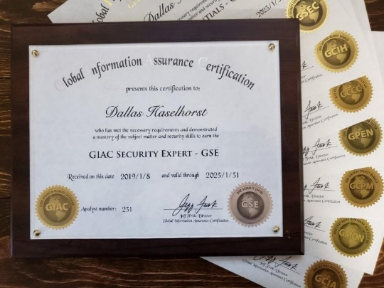


# whoami
25+ years of IT & cybersecurity experience
Consulted for companies all over the world
Multiple computer-related degrees from FHSU
Master’s degree in Information Security Engineering from the SANS Technology Institute
Alphabet soup of security-related certifications
CISSP, GSEC, GCIH, GCCC, GCPM, GPEN, GMON, GCIA, GWAPT, GDSA, GSE #231
Co-organizer of BSidesKC cybersecurity conference
Founded IT provider (MSP) in 2003, acquired in 2016
Founded TreeTop in 2016, lead design on Peak platform
Founded 501(c)(3) STEM Harvest in 2021 - stemharvest.org
Example
Notes:
My background. This is a chance for you to tell the audience a little bit about yourself. Include information about how you relate to the subject such as why you enjoy helping people avoid scams, why you're qualified to talk about cybersecurity, etc. Maybe it’s because you were scammed yourself so you have some additional insight. Personal stories can go a long way to helping attendees better understand the material and make it more relatable.
This content is free! If you feel the need to compensate us for our time, please instead send a donation to STEM Harvest, which is a 501(c)(3) non-profit to help teach kids in rural Kansas about technology. There are numerous ways to donate via the https://stemharvest.org website.

Slide 5

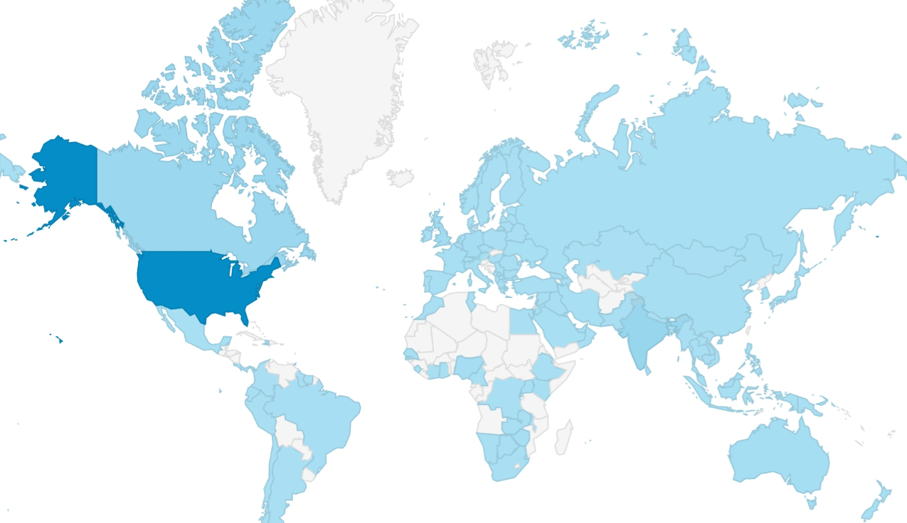
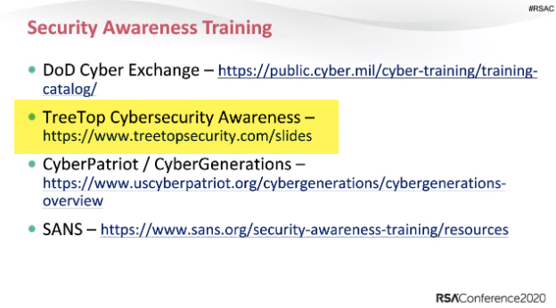
About this presentation
Latest version is available at https://www.treetopsecurity.com/CAT
Version 1.0 downloaded in over 150 countries in first 6 months! Sept 2019 - March 2020
Shared and recommended at cybersecurity conferences including RSA
Notes:
In the first 6 months after it was released, version 1.0 of this slide deck was downloaded in over 150 countries. Since then, it has been downloaded hundreds of thousands of times. It is downloaded or viewed over 10,000 per month and those are just the views we can reliably count! This presentation is consistently receiving feedback from people all over the world so it can continue improving. Many organizations use the slides as part of their new employee training or as a part of their ongoing employee training. This deck has been recommended by numerous IT and security experts. In February 2020, it was shared alongside some other fantastic resources at the RSA security conference, which is one of the largest security conferences in the world.
Note: The red arrow pointing at the slide number is a reminder for presenters to mention this material is available for download from the TreeTop Security website, https://treetopsecurity.com/CAT, i.e. there’s no need to hurriedly write down everything from every slide. The slide number also makes it easy to reference with attendee notes.

Slide 6

Legal disclaimer
While we'd love to boast that our cybersecurity awareness training is as foolproof as a rubber umbrella in a thunderstorm, we need to clarify a few things. No training can safeguard you from all cyber threats. Even our amazing training used around the world might not be “enough” to protect you from a cyber criminal’s relentless attempts to send you malware laced cat memes. So despite our best efforts, this training is not perfect... It’s sad to say out loud, but it’s the truth! It is, however, the best single hour you can use to learn ways to better protect yourself from the evil lurking on the digital interwebs. As you go through this slide deck believing you are witnessing the reincarnation of Bill Shakespeare, remember that your best defense against cyber-foolery is your own cyber-wisdom. Remain vigilant, keep your passwords as complex as the plot twist in Fight Club, and learn to embrace your inner cybersecurity awareness ninja!
TreeTop Security - CAT - v2023.09
Note: We were told we needed a disclaimer stating this training wasn’t perfect so we are. Many thanks to ChatGTP for adding some flair and making it one of the funniest disclaimers I’ve ever read.
Notes:
We were told this training needed a legal disclaimer because someone might think this 1 hour training would make them immune from cyberattacks. Let’s add a disclaimer that states this, but makes it funny so people will actually read it. A little ChatGPT, a little extra flair, and this is the result! To all of my lawyer friends, sorry not sorry.

Slide 7

Notes:
Live, laugh, get hacked, stop laughing. It's meant to bring a little bit of light to the subject but keep in mind that cybersecurity is affecting a lot of people in very adverse ways after their data gets hacked, their company gets breached, a product or service they use gets hacked, etc.

Slide 8
Overview
Why security awareness?
Backup, backup, backup
Patching ALL of your devices
Passwords
2-factor authentication
Internet safety & email
Phone scams
Privacy concerns
What to do when things go wrong
Notes:
We have a lot of ground to cover. Generally, why is security awareness important. From there, some ways to protect yourself including privacy concerns. And last but not least, what should you do if you or someone you know *thinks* they may be the victim of a scam.

Slide 9

Why is cybersecurity awareness important?
Notes:
Let’s get started...

Slide 10
Awareness training is a must!
Technology alone *cannot* protect you from everything
Attackers go where security is weakest
People -> a link in the chain & the last first line of defense
A must to reduce cybersecurity risk
Cybersecurity awareness is for...
Employees
Business owners
Parents
Kids
Seniors
Everyone!
Reminder: Many tips that keep you safe
at work will also keep you safe at home!
Notes:
Cybersecurity awareness training is to vital to security. This is a key topic because many people assume if they have the best security technologies, it will provide them with 100% coverage. Example: Large corporations and governments spend millions of dollars and still aren’t immune from cyberattacks. Another common belief is that our IT department will take care of it or they assume a firewall and anti-virus will protect them against anything. Cybersecurity awareness is a must for everyone! Also hit on the fact that they tips work at home too. That tends to help keep the interest of audience because they know this could save them money or time if they get malware, scammed, etc.

Slide 11
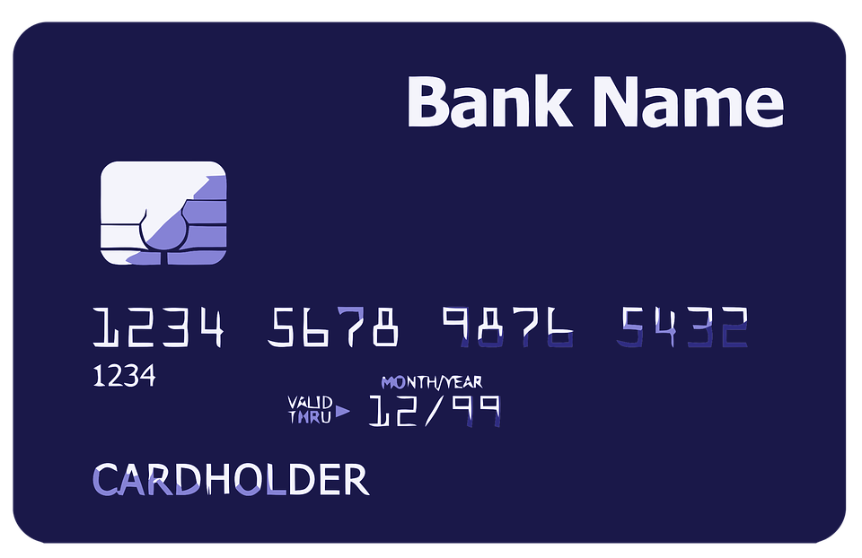


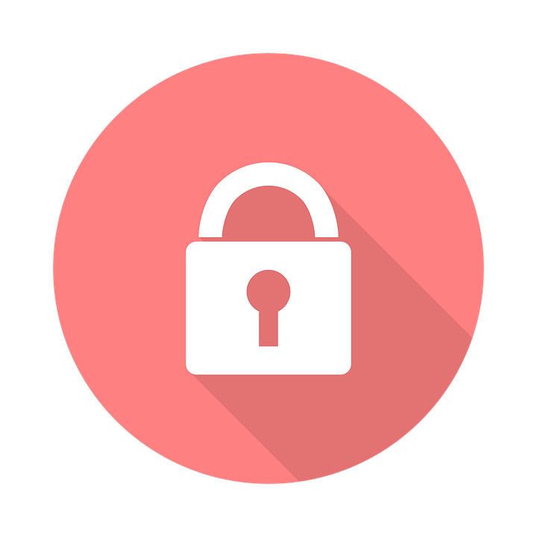
But an attacker isn’t interested in me...
Wrong!!! You are exactly what an attacker wants!
Credit card and financial data
Medical data
Prescription, insurance, or identity fraud
Far more valuable than financial data
Computer resources
Cryptomining
Advertising
User or email credentials
Sending spam
Recovery/reset other accounts
Ransomware
Jump point
“More” access
Notes:
The bottom line is that everyone has something that an attacker wants. With data, it could be financial, personal, or even medical related. Even if someone claims they don’t have anything on their computer worth stealing, an attacker can still use their computer resources for cryptomining. Cryptomining uses your computer resources for financial gain. Attackers have also injected ads into users’ browsers to provide them advertising revenue. Or they could use your computer as a jump point to attack someone else. This is also a good time to ask if everyone knows what ransomware is. A go-to analogy is comparing it to a Hollywood kidnapping movie where the criminals ask for a ransom to get the person back. Ransomware is similar, except it is keeping you from accessing your data unless you pay the ransom. Something we frequently hear is that we only do email on this computer. Ok, but what other accounts might be tied to that email. For example, if I’m a bad guy and I have access to your email, do I need your bank password? Why not just go to your bank website, say “forgot password” and then have the new password sent to me? That last comment is typically a light bulb moment for a lot of attendees.

Slide 12

HELP!!!
Ways to protect yourself!
Notes:
Enough of the doom and gloom, let’s get into ways to protect yourself.

Slide 13
Backups
Backups protect when all else fails
NO level of protection is perfect
Only “guaranteed” protection against ransomware
Backup media should *not* be connected at all times
Test your backups! Restore, restore, restore...
35%
25%
20%
11%
20%
Users that have never backed up
Users that backup yearly
Users that backup monthly
Users that backup daily
TreeTop Security - CAT - v2023.09
Source: Backblaze
Notes:
Backups are absolutely necessary for security. Backup media (such as a USB drive) cannot stay connected all the time because if you are hit with ransomware, it will almost certainly encrypt the USB backup files as well. Also, don’t forget to test your backups! As any person in IT can attest, there are an endless number of companies who thought they were backing up their data every day only to found out differently when they go to recover data. Pro tip: Tell them to add testing restore processes to their calendar every quarter. We never dive into all of the statistics at the bottom because that can get tedious, but we do often highlight the statistic at the bottom that is in white (instead of gray). In this case, 20% of users have never backed up their data. Source: https://www.backblaze.com/blog/the-state-of-backups-whos-most-at-risk/

Slide 14

Worksheet #1 Your data, your backups https://www.treetopsecurity.com/CAT
Notes:
This page refers to the worksheet on backups. https://www.treetopsecurity.com/CAT

Slide 15

Updates are essential to security
What was secure yesterday may not be secure today
New software vulnerabilities are found every day
Over 450,000 new malware (viruses & ransomware) released every day
Nothing is “Set & Forget”
Source: AV-Test
Notes:
Most people think of updates and think of Windows, Mac, or phone updates and the handful of new features they receive. Many are not aware that those updates also include fixes to better protect them. Statistic source: https://www.av-test.org/en/statistics/malware/

Slide 16






Keeping your system up-to-date
Operating Systems
Microsoft Windows, Apple MacOS, Linux
Windows 7 end of life was January 2020
Anti-virus
Update to the latest definitions to ensure protection against the latest threats
Symantec/Norton, McAfee, Windows Defender, Avast, and many others!
Notes:
Keep your systems up-to-date. Don’t just ignore updates until the system forces you to update.
Most people don’t understand how traditional anti-virus works so this might be an opportunity to explain why receiving virus definitions on a regular basis is a must. A great analogy tends to be an entry/patron list for a high-end restaurant, i.e. that list operates by ONLY allowing people in whose name are on the list. Traditional anti-virus is the opposite, i.e. it operates by preventing someone when their name is on the list. What that means is if your list isn’t up-to-date, you’re not blocking everything you should be. This “deny” approach is why traditional anti-virus largely doesn’t work in today’s internet. As a reminder, the previous slide highlighted the insane number of new pieces of malware released every day.

Slide 17
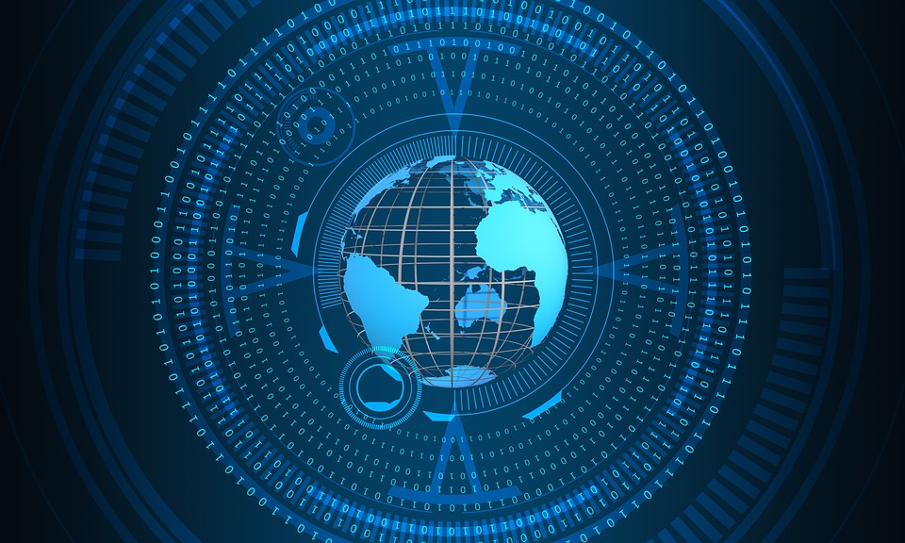








Don’t forget to update…
Browser - your portal to the internet
Chrome, Firefox, Edge, Safari, Brave, etc.
Internet Explorer (Not recommended)
Mobile devices - cell phones & tablets
Internet of Things (IoT) - Alexa, Google Home, light bulbs, thermostats, doorbells, surveillance system, smart locks, pet feeder, vacuums, health monitors... This could keep going forever!
Notes:
Tons of other applications/apps on your computers and phones also need updating. An up-to-date browser is vital. At this point, Microsoft no longer recommends using Internet Explorer to browse the web. Inevitably, there will be a hand or two raise stating they must use Internet Explorer for certain websites, often government related. The standard response is if that is the case, then those websites should be the ONLY ones you use IE on.
“Internet of things” devices also need updates and a majority of these devices will be problematic for years to come. Why? Because most do *not* receive automatic updates, i.e. that wifi-enabled dog feeder you had to have may cause security issues down the road if you’re not careful.
You might get asked about how to handle those types of devices. Either a) don’t buy them or b) segment them onto their own network. Let them know you can chat after the training if they have additional questions about that.

Slide 18

Worksheet #2 What’s on your network? https://www.treetopsecurity.com/CAT
Notes:
This page refers to the worksheet that guides an attendee through scanning a network. https://www.treetopsecurity.com/CAT

Slide 19
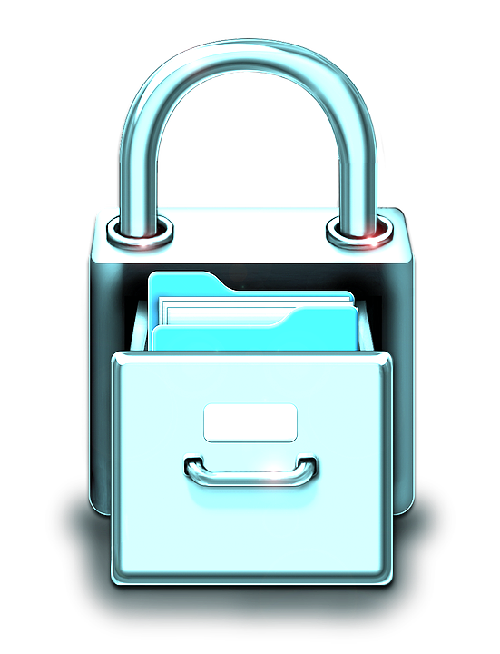
All
About
Passwords
Notes:
These transition slides are a great place to pause and ask if anyone has questions. It is also a great way for someone consuming a lot of new information to reset their thoughts.

Slide 20
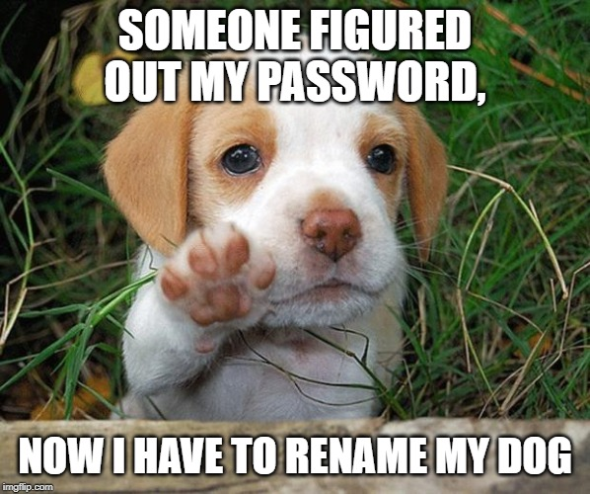
Notes:
Give everyone a chance to read it and then explain the joke, i.e. it’s easier for some people to rename their dog than for them to change their password. And he’s such a cute little puppy! ;-)

Slide 21
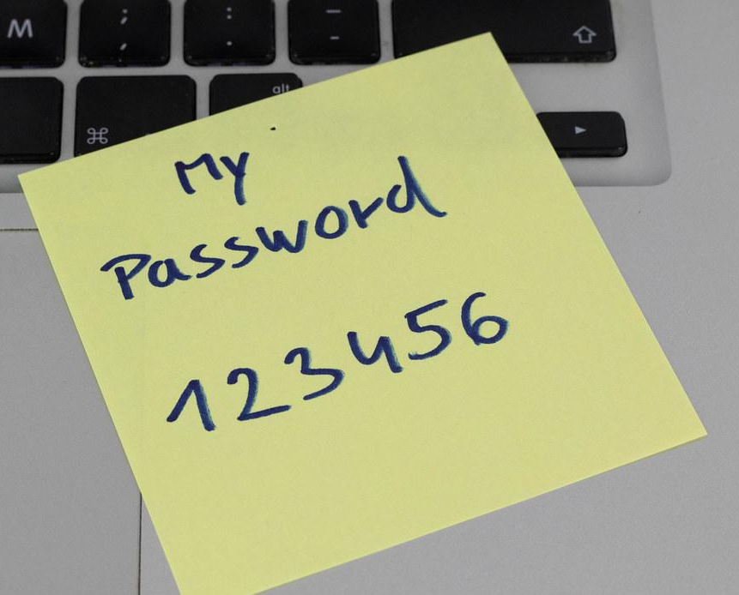



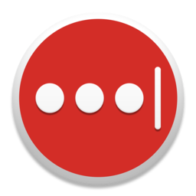
Managing Passwords
Keep your passwords in a secure location
Do NOT use paper or sticky notes
Do NOT store passwords in clear-text on your computer - Word, Excel, etc.
Utilize a password manager (aka vault)
Bitwarden
Chrome?
Benefits of a password manager
One strong password to access them all
Passwords are stored securely
Auto-fill username/password on websites
Sync between desktop, laptop, and mobile
KeePass
LastPass
Apple Keychain?
X
Notes:
This slide often generates a LOT of discussion. It’s extremely common for people to come back and tell us about how they implemented a password manager at some point after the training.
It’s never a bad idea to explain that the first thing an attacker or malware does after gaining access to a system is to look for way to gain access to OTHER systems. What better way to do that then by looking for usernames/passwords the user might have laying around?
Inevitably, someone will ask about built-in password managers such as Google Chrome or Apple Keychain. Long story short, they are better than not using a password manager, although they are not quite as secure. They also have some drawbacks including locking you into a particular ecosystem, browser, etc.

Slide 22

Password Tips
Avoid using items that can be associated with you
Address
Phone numbers
Pet names
Separate passwords for every account
Auto-generated, near impossible to guess
Child names
Birthdays
Sports teams
Easy with a password manager
42%
52%
59%
13%
Rely on sticky notes for password mgmt
Re-use password for multiple accounts
Use name or birthdate in password
Reuse same password for all accounts
TreeTop Security - CAT - v2023.09
Source: Comparitech
Notes:
This is pretty self-explanatory. We often have to explain that it is ok to *not* know or remember a password. That is exactly what your password manager is for. Don’t forget the highlighted stat below that 52% of all people re-use passwords for multiple accounts. One question you can ask here is why using a different password is important, i.e. if one website gets breached, an attacker will attempt to use that same username and password on other sites. Source: https://www.comparitech.com/blog/information-security/password-statistics/

Slide 23
Passphrases, not passwords?
Useful when passwords must be typed in
Computer login
Should not be easy to guess
At least 12 characters, but 15 or more is far better
Length better than “complexity” - upper, lower, number, & special characters (~!@#$%^&*_-+=`|\(){}[]:;"'<>,.?/)
Bad password (8): P@ssw0rd
Great password (25): MysonwasbornNovember1995!
Wireless <- no phone numbers!
Why are most passwords exactly 8 characters?
Notes:
The important takeaway is that length matters far more than complexity. We also like to point out the “great” password and how no one probably would have thought they could remember a 25 character password. However, it’s pretty easy to remember that particular one and better yet, it even meets all password complexity requirements for systems that still require them.
A quick side note about why you should *not* use phone numbers for wireless passwords. I personally first became aware of ISPs setting up customer wireless passwords as their phone number back in 2015. I quickly discovered it wasn’t limited to my community based on internet feedback. I blogged about my own experience many years ago after several ISPs were STILL following this bad practice despite me providing evidence years earlier showing them the dangers. The worst part is that it’s STILL a common practice for numerous ISPs and users today. :-( Aside from the obvious that it doesn’t take much to find someone’s phone number, an all number password with a known length can be cracked in well under a minute. Here’s the original story from my blog with technical details of how it works. https://linuxincluded.com/why-phone-numbers-make-horrible-wifi-passwords/
The question at the bottom is to get the attendees to think about why. The answer is because almost every system and website on the planet has 8 characters as the minimum length… And given the choice, most will choose the minimum because they don’t fully understand the security implications.

Slide 24
Top 20 passwords by rank & year
Rank | 2020 | 2021 | 2022 | Rank | 2020 | 2021 | 2022
1 | 123456 | 123456 | password | 11 | 1234567 | qwerty123 | 1234567
2 | 123456789 | 123456789 | 123456 | 12 | qwerty | 000000 | 1234
3 | picture1 | 12345 | 123456789 | 13 | abc123 | 1q2w3e | 1234567890
4 | password | qwerty | guest | 14 | Million2 | aa12345678 | 000000
5 | 12345678 | password | qwerty | 15 | 000000 | abc123 | 555555
6 | 111111 | 12345678 | 12345678 | 16 | 1234 | password1 | 666666
7 | 123123 | 111111 | 111111 | 17 | iloveyou | 1234 | 123321
8 | 12345 | 123123 | 12345 | 18 | aaron431 | qwertyuiop | 654321
9 | 1234567890 | 1234567890 | col123456 | 19 | password1 | 123321 | 7777777
10 | senha | 1234567 | 123123 | 20 | qqww1122 | password123 | 123
If you use any of these, change them NOW!!!
Source: Nordpass
Notes:
Pick out a few passwords and discuss them. The takeaway is that these “terrible” passwords don’t change much. The other point you might make is “how do we know what passwords people use?” These passwords are from hacked databases *after* a breach occurs. Security researchers then analyze those hacked accounts to search for similarities. Remember our discussion on why you should have a different password for each website? Source: https://nordpass.com/most-common-passwords-list/

Slide 25
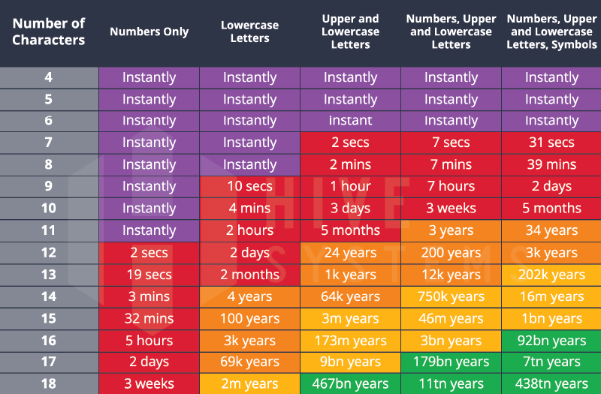
Password length <-> time to crack
Time for an attacker to brute force passwords. Are you in the yellow or green?
Source: Hive Systems
Notes:
This table/data is slightly nuanced. What it does well is provide the average user an easily way to visually understand how longer passwords are exponentially better than shorter passwords. Source: https://www.hivesystems.io/blog/are-your-passwords-in-the-green

Slide 26
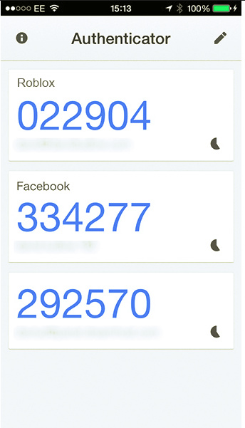

2FA - two-factor auth
What is 2FA?
“Beyond” a username and password
Second form to prove it is you
Typically out-of-band
“Your one-time code is…”
SMS
Phone call
Applications
Google Authenticator
Microsoft Authenticator
Built into password manager?
Email
Phone pop-up
Not as secure
99.9% LESS likely to be compromised if you use MFA.
Source: Microsoft Tech Community
Notes:
People’s eyes tend to glaze over when talking about two-factor authentication. I usually explain that if you have logged into your bank account and it sent you a text message stating “your passcode is…” then congratulations, you’ve used two-factor authentication. A short discussion on how the phone-based applications work never hurts either.
While any form of 2FA is substantially better than a username/password by itself, it’s important to recognize that SMS and phone call-based verifications have some security concerns. Aside from SIM-jacking (or SIM-swapping), which is where an attacker coerces a cell phone carrier to issue a new SIM card, there are other attacks that allow an attacker to re-direct SMS and phone calls to a new device. Unfortunately, it can happen for as little as $16, although there are some caveats.
Source: https://www.vice.com/en/article/y3g8wb/hacker-got-my-texts-16-dollars-sakari-netnumber Don’t miss the opportunity to briefly discuss the quote from Microsoft stating their research showed that 99.9% accounts are LESS likely to be compromised if you use multi-factor authentication (MFA) or 2FA. <- Wow! Source: https://techcommunity.microsoft.com/t5/microsoft-entra-azure-ad-blog/your-pa-word-doesn-t-matter/ba-p/731984

Slide 27
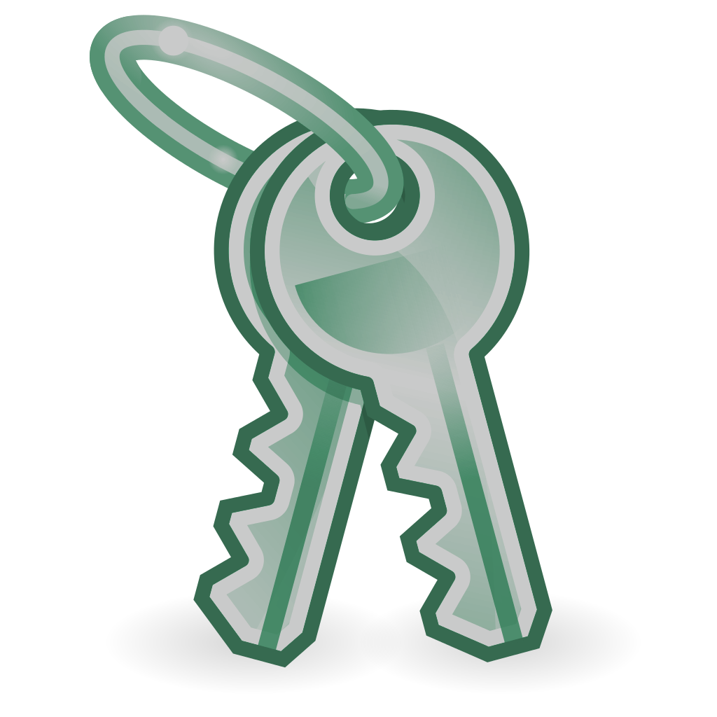
Worksheet #3 Password managers & 2FA https://www.treetopsecurity.com/CAT
Notes:
This page refers to the worksheet that guides through the initial setup of a password manager and some discussion on 2FA. https://www.treetopsecurity.com/CAT

Slide 28

Just
A Little
Click
Notes:
Another opportunity to ask if anyone has questions and let them do a mental reset as we move onto some different concepts.

Slide 29
Is the link safe in 4 steps
1. Verify
4. Click
04
Were you expecting a link?
Not just email!
Social Media
SMS/iMessage
Zoom, Teams, Slack, etc.
Does it pass all 3 tests? Still use caution “When in doubt, throw it out”
01
03
2. Hover
3. Sniff test
Hover over the link to ensure that it leads to where it says it does
Is it a site you recognize? Does it feel “familiar” to you? Be skeptical
02
Notes:
Go around the circle with a brief explanation on each. Go quick because we go into many of these more in-depth so simply help attendees understand that these 4 simple steps can help prevent link-based attacks. The big one is to point out that links aren’t just email.

Slide 30
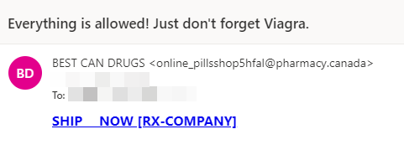
Easy to recognize scam
Red flags?
Viagra <- ?!?!?!
Strange wording
Email address
Domain name
Expected email?
Interesting link
Notes:
This should hopefully be an easy to spot scam (spam) for most everyone. Go through each of the red flags and talk about how you can use this same, systematic approach to all emails and even some non-email scenarios.

Slide 31
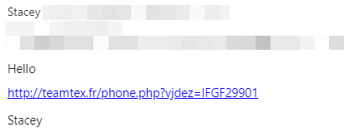
From known email account
Hacked or spoofed email from someone you know
Similar attacks via Facebook & social media
Red flags?
Email address ok
Name ok
Odd “signature”
Expected email?
Link - .fr is France
Notes:
This might be more difficult to spot because it is from someone you know, but their account was hacked. You may ask if anyone has experienced this or if they know of someone this happened to. Remember to get the audience involved! Although not email related, everyone with a Facebook account has likely experienced this situation where a friend gets their account hacked and you get a odd message like “Is this you in this video” or something similar.

Slide 32
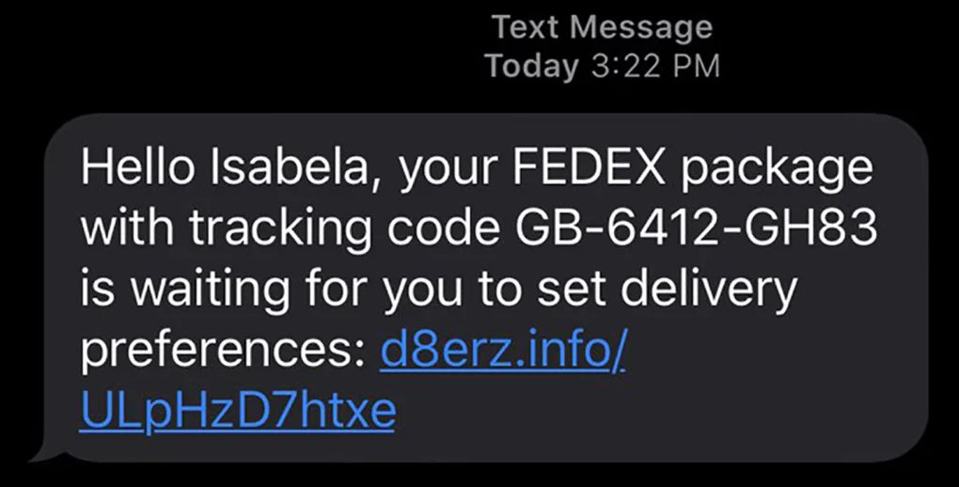
Text messaging example
Red flags?
Name in SMS ok
Number ok?
Expected text?
Received a text regarding a package before?
Recognized domain?
Image source: CNN
Notes:
Reminder: links aren’t just for email! This is an SMS text message claiming to be FedEx. Were you expecting a package? Have you ever received a package notification via text message before? Also, note the odd domain name.

Slide 33
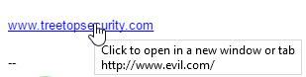
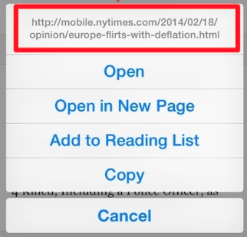
Hover before you click
Why hover?
Blue text can be deceiving
Underlying URL may be different
“Foreign” domains - .uk, .cn, or .ru
Numbers instead of letters
Example: 192.168.1.1
Don’t trust it!
Hover on mobile/tablet?
Long press (hold)
Any doubts? Don’t click it!!!
Desktop - Hover
Mobile - Long Press
http://www.evil.com/
Notes:
Hovering is your friend. Hovering shows where the link will take you *before* you click on it. If you see numbers, then there is a really good chance it isn’t legit. Also, if you are on a mobile device or table you can still hover by performing a long press. Be careful though because if you don’t hold down the long press long enough, you will unintentionally click the link!

Slide 34
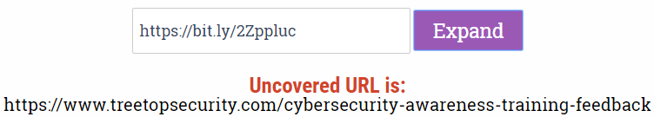
Shortened or obfuscated links?
Instead of 300 characters, the link is reduced to 15 characters
Bit.ly
TinyURL
Extremely common and helpful, but...
Abused by criminals to hide malicious websites
Link expander www.linkexpander.com
Notes:
Don’t spend a ton of time here other than to explain how link shortening services work. If they come across this, you can use a number of services including Link Expander to show the *actual* URL, e.g. if you expand the bit.ly link in the picture it expands to the fairly long URL for our TreeTop cybersecurity awareness feedback.

Slide 35
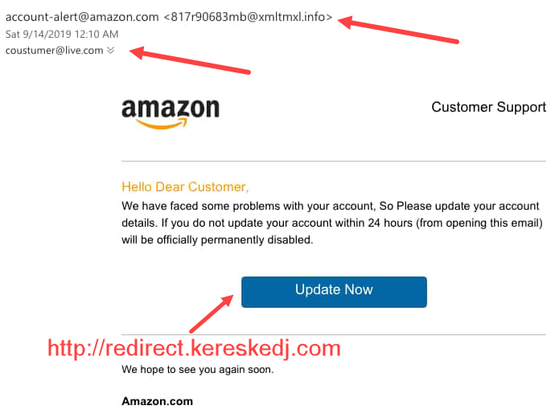
Hover is your friend
Email address ok?
Expected email?
Sense of urgency
HOVER!!!
Red flags?
Source: Malware Traffic Analysis
Notes:
Hovering in action. But first, do you use Amazon? If this is a business account, have you ever received Amazon (or vendor) email before? Note the sense of urgency the attacker is trying to use to their advantage. We’ll see that time and time again in numerous attacks including phishing schemes. Take a look at the email address. Is that really Amazon? Last but certainly not least, if you were to hover over the “update now” button, it revealed another extremely odd website.

Slide 36

More email attacks
94% of malware is
delivered by email
1.2% of all emails sent are malicious
Over three billion phishing emails every day
Sources: ZDNet | Verizon DBIR
Notes:
Another chance to reset, but also point out that you’re continuing on with other email attacks. Why more email attacks? Because 92% of malware is delivered by email.

Slide 37
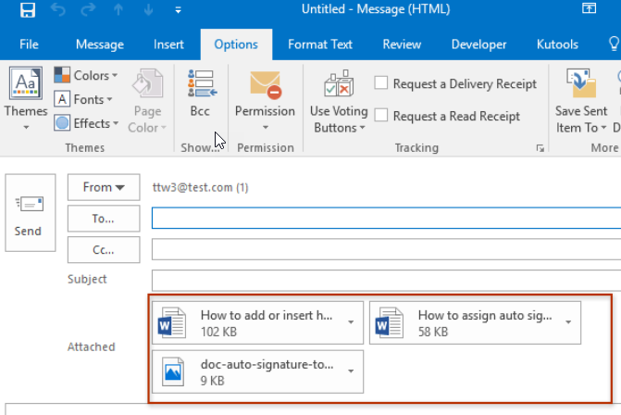
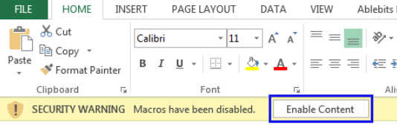
Email Attachments
Attachments in email client (Microsoft Outlook)
Stop & think before you click!
Recognized sender?
Expecting attachment?
Is it normal for that contact to send attachments?
Macros
Step 1: Don’t do it!!!
Step 2: See step 1
Found in downloaded files too
Enable Macros <- NOOOOOO!!!!
Notes:
Email attachments can appear in Microsoft Outlook or any other email client including your browser. The best defense is to stop and think. Do you recognize the sender and do they normally email you attachments? A frequent example to use here might be someone’s parents or grandparents. Sure, they might email but would it be weird to get a PDF document from them out of the blue? Macros are worth mentioning because they are still used. Basically, if someone knows what macros are then they should use caution when opening documents with them (and enabling content). If you don’t know what macros are, don’t ever click enable content. Why? Because by clicking on that, a Word document or Excel spreadsheet can infect your computer.

Slide 38
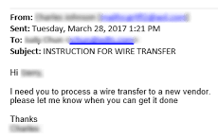
Business email compromise (BEC)
FBI: BEC cost businesses $1.8B every year
Moving funds -> more susceptible
Policy requiring phone call?
“Trusted” senders
Research using publicly available data
Published organization chart
Spear phishing (CEO <-> CFO)
Spoofed domain
microsoft.com - micros0ft.com
Compromise account of 3rd parties
Employee, vendor, or customer
Thread hijacking <- lookout
Wire transfer
Often requires very little technical skill
Source: Dark Reading
Notes:
Many organizations have published organization charts (or even board of directors) because it lets others get familiar with them. Unfortunately, attackers can use them to gain a better understanding of an organization or decide who they would like to target. In this example, no technical control can help because this could just as easily be a legitimate request. Often times, something as simple as implementing a company policy for a follow-up phone call would thwart many of these attacks.
This might be a good time to use a story from your area or depending on your audience, you could also talk about Barbara Corcoran from Shark Tank and how she almost lost $400,000 from a phishing email. In Barbara’s example, her assistant was sent an email asking for renovation funds, which is a common ask in her line of business. Fortunately, the reply included her and she was able to put a stop to the wire transfer (and scam). For most of these, it requires almost zero technical skill because it looked like it was coming from a trusted source.
We've seen a HUGE uptick in thread hijacking. Thread hijacking is when someone else that you know (and trust) gets their email account compromised; the attacker then utilizes previous conversations on new emails to make it seem more plausible. This can occur from an currently compromised account or MONTHS later after the attacker no longer has access, i.e. the attacker will send an email from an external system posing as that person so you simply assume they are replying to your conversation from a different email address. Source: https://www.darkreading.com/attacks-breaches/fbi-business-email-compromise-cost-1-8b-in-2020 Source: https://www.cnbc.com/2020/05/06/how-barbara-corcoran-almost-lost-400000-dollars-to-an-email-scam.html

Slide 39
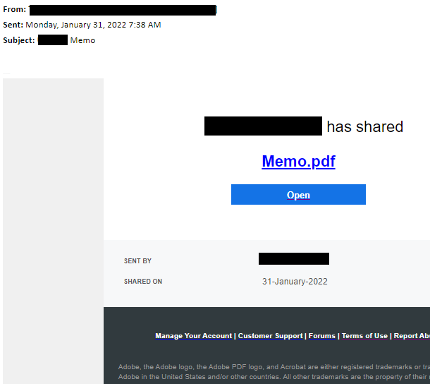
Customer BEC example
Small business < 100 employees
CEO received email
From school district (their customer)
Bid proposal
Busy CEO blocked, certain it was legit
Asked us to “bypass” blocks/alerts
Give us 5 minutes
Contacted school IT
“You’re the 2nd call”
All within 30 mins of 1st alert
Image source: TreeTop Security
Notes:
This is a scenario we worked for a customer and this is nearly the same email the customer received. Was this a big business? No! It was for a customer under 100 employees. The CEO received a RFP (request for proposal) from a school district contact he was extremely familiar with. These type of emails are VERY common for them. The email made it past the email phishing protections, but it was blocked via a separate security control. Yay for security defense-in-depth! ;-) We received alerts about the blocks and we were already investigating it when the CEO reached out asking us to bypass the blocks. About a little research, we were convinced the email was likely malicious we decided to contact the school IT department; the school told us they had already received another call and they believed they had a compromised account.

Slide 40
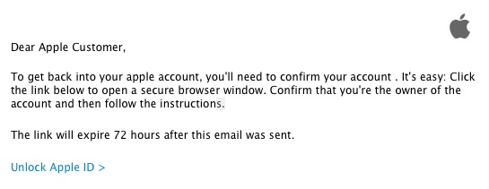
Other Email Scams
Mostly “non-technical”
What the attackers want
Money
Gift cards
Wire transfers
Access to email & accounts
Possible signs
Sense of urgency
Never happened before
No limit on what they say/do
Account credentials
Credit cards
Technology alone cannot solve this
Notes:
Yes these are still over email. The non-technical statement is meant to point out that just because there might not be any links or attachments, doesn’t mean it isn’t malicious. You can easily ask for someone to send gift card numbers via email and unfortunately, a lot of people fall for this scam. Likewise, an attacker introducing themselves as tech support and then asking someone for their password isn’t a technical attack per se, however, it is still widely used because it works! Similar to prior examples, point out some of the tell tale signs such as the sense of urgency, recognizing something as “off” because it’s never happened before, etc. It’s also important to recognize that attackers have NO limits on what they can say or do. There have been several examples of attackers claiming there was an active shooter situation at a school, they want money to get someone out of jail, etc.

Slide 41
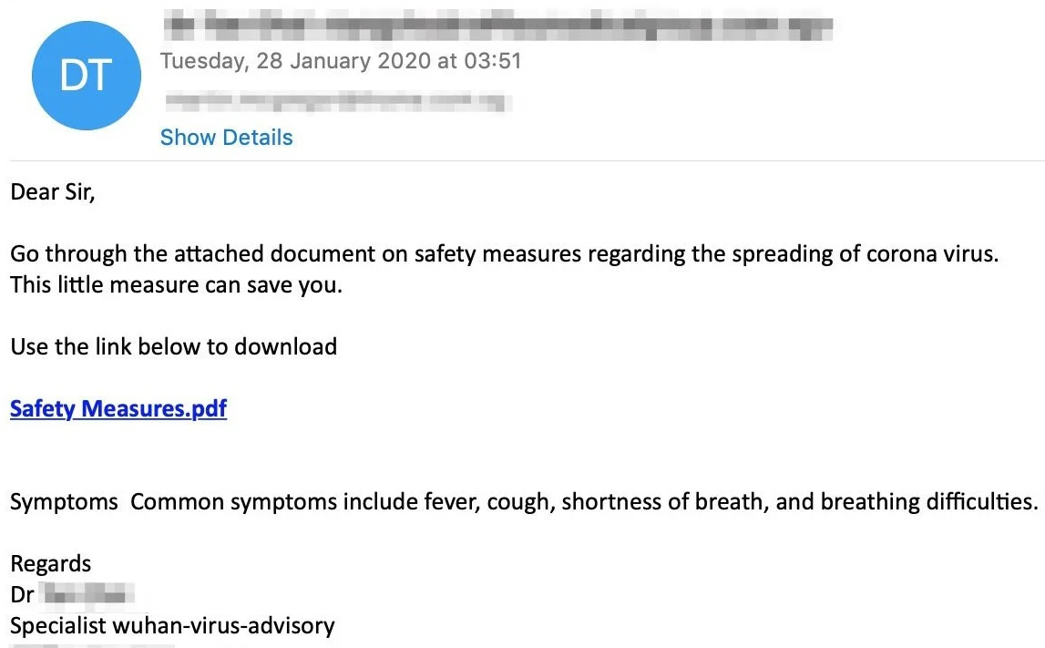
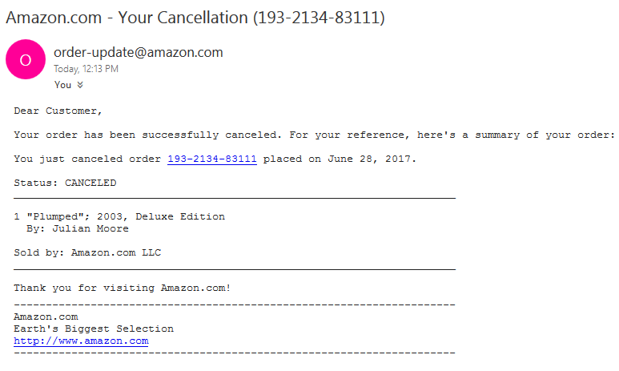
Scammer favorites
Recent events - coronavirus
Mimic recent, breaking news
Worldwide
Health scares
Protests
Elections
Local and regional
Seasonal/holidays
Order & delivery issues
Tax issues
Order Cancelled
Keep your guard up!
Notes:
Scammers always have and always will use news headlines in their attacks so you put your guard down. During the last few years, scammers used coronavirus themed attacks for phishing campaigns. Around the holidays, they will use cancelled orders or delayed deliveries because people are ordering gifts for loved ones. These tactics will *never* change.

Slide 42
Worksheet #4 Have you been part of a breach? https://www.treetopsecurity.com/CAT
Notes:
This page refers to the worksheet that guides a user through looking up whether their data was part of a previous breach using the awesome resource, https://haveibeenpwned.com. https://www.treetopsecurity.com/CAT

Slide 43
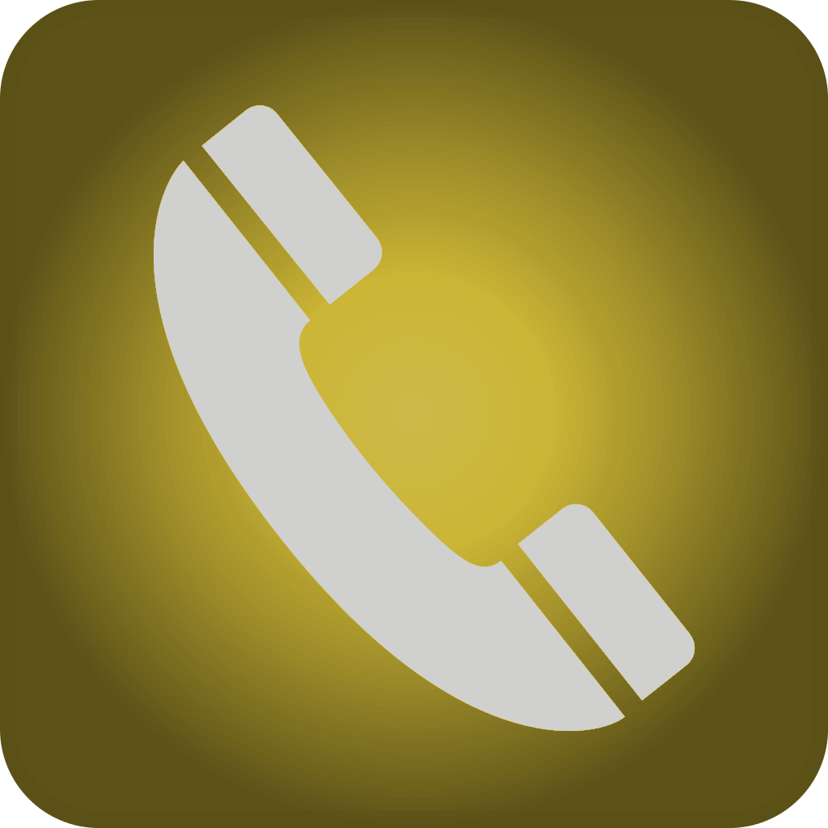
Reach Out & Scam Someone
Notes:
A great chance to reset and ask if anyone has questions before moving onto the next topic.
A US phone company once said “reach out and touch someone” so this is a little play on that.

Slide 44
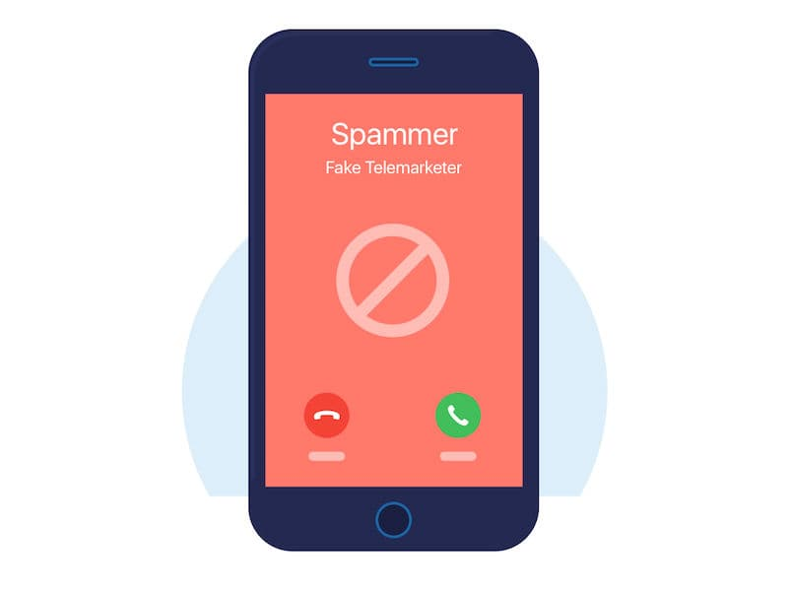
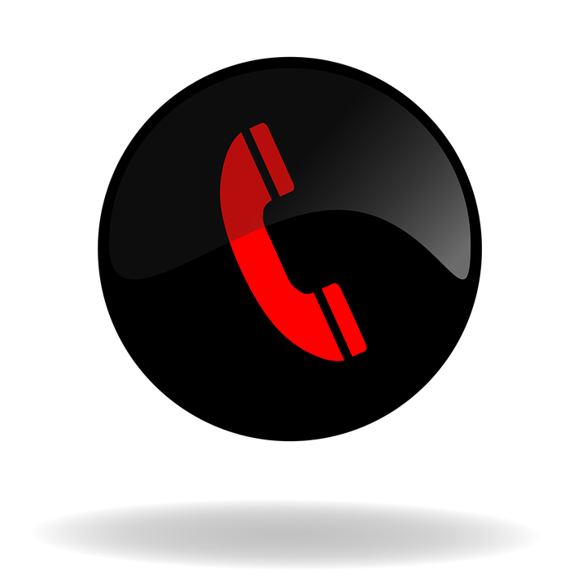
Phone Scams
Social engineering, what is it?
Banks & credit card companies
Medical & insurance
IRS or any past due account balance
Objective: access your sensitive info
Phone numbers can be easily spoofed
Make the caller provide verification
Hang up & call back a published number
Other common phone scams
Grandparent Scam
Tech support - Microsoft, Apple, Dell, etc. will never contact the average user “out of the blue”
Notes:
A quick chat on social engineering and how attackers use it to gain information, gain access, etc. Sometimes attackers will pose as banks, energy companies, or someone else to get your payment information. A social engineering tactic may include calling you from a “recognizable” phone number. Most people don’t realize how easy it is to spoof a phone number, which makes it trivial to make their phone call look like it is coming from the local electricity company, phone company, hospital, etc. This is done in an effort to get people to let their guard down. If someone calls and their phone number matches someone you are familiar with, be skeptical. It’s usually easiest to simply tell them you are busy, hang up and call them back at a published phone number that you have in your possession. We always highlight the tech support scam because we saw it so many times over the years. As callous as it may sound, Microsoft, Apple, Dell, etc. will never call you out of the blue to tell you about a problem on your computer or device.

Slide 45
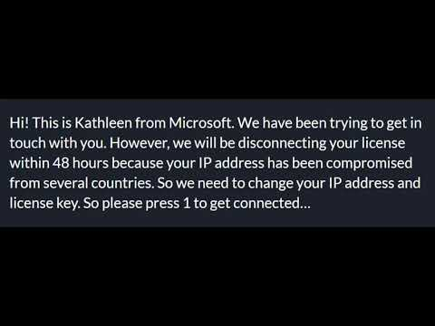
Phone scam example
Hi! This is Kathleen from Microsoft. We have been trying to get in touch with you. However, we will be disconnecting your license within 48 hours because your IP address has been compromised from several countries. So we need to change your IP address and license key. So please press 1 to get connected…
Sense of urgency
Purposefully confusing
Expected call from Microsoft?
Red flags?
Technical safeguards can only do so much... That’s why security awareness is a must!
Notes:
If you have audio, let the audio play. If it doesn’t work or you’re not sure on the volume/quality, let the audience know the white text is the same as what is stated in the audio clip. Highlight the red flags because several of them are the same tactics we used to spot phishing email. Also highlight that there is very little we can do from a technical perspective to block this attack.

Slide 46

General Tips
&
Privacy
Notes:
Once again, a great time to take a breather and ask if anyone has any questions? Moving onto the last section!

Slide 47
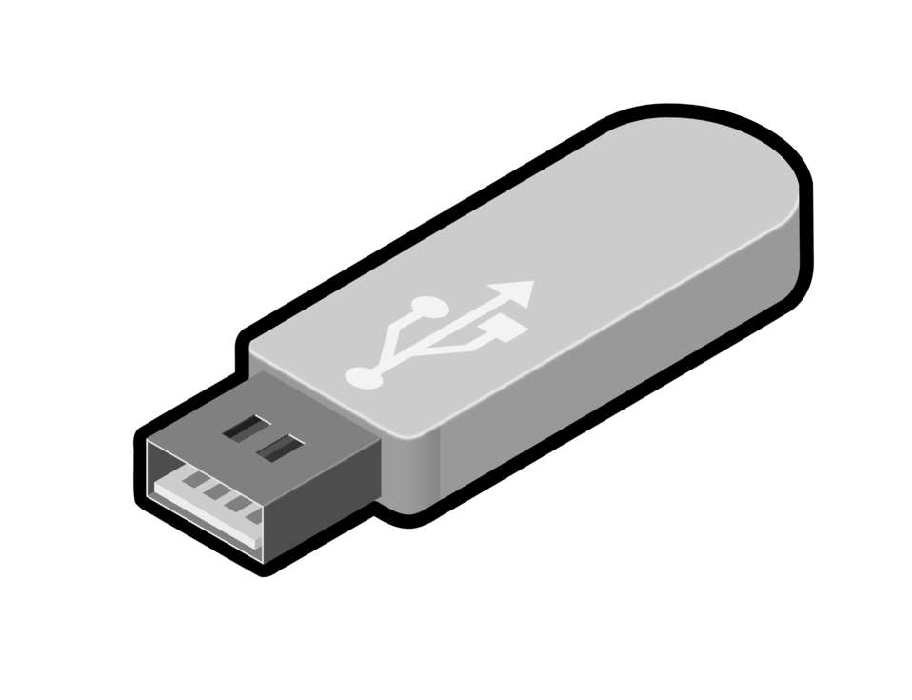
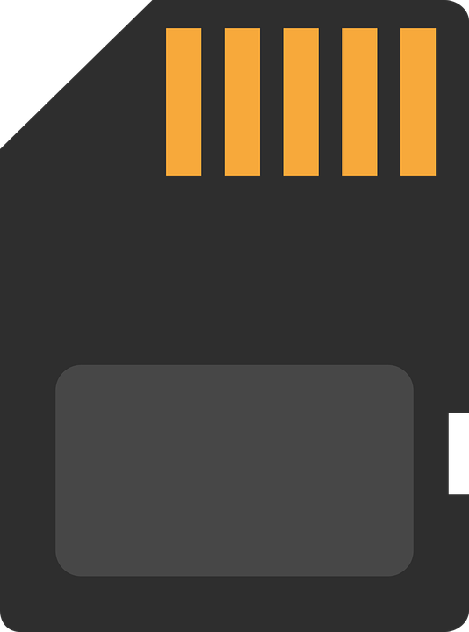
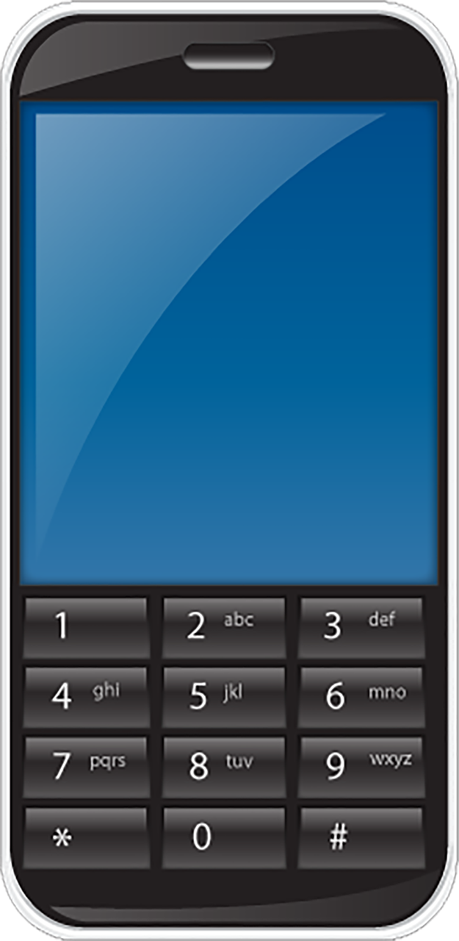

USB Drives & More
Do NOT connect unknown or unauthorized media (or devices)
Programs can run when plugged in without you doing anything
Examples
USB/flash drives
SD or micro SD cards
CDs or DVDs
External hard drives
Cell phones <- Often forgotten
Notes:
I often use the example of how attackers have mailed USB drives or even left them in parking lots knowing someone would plug them in. Most people don’t realize these devices can infect your computer simply by plugging it in.

Slide 48
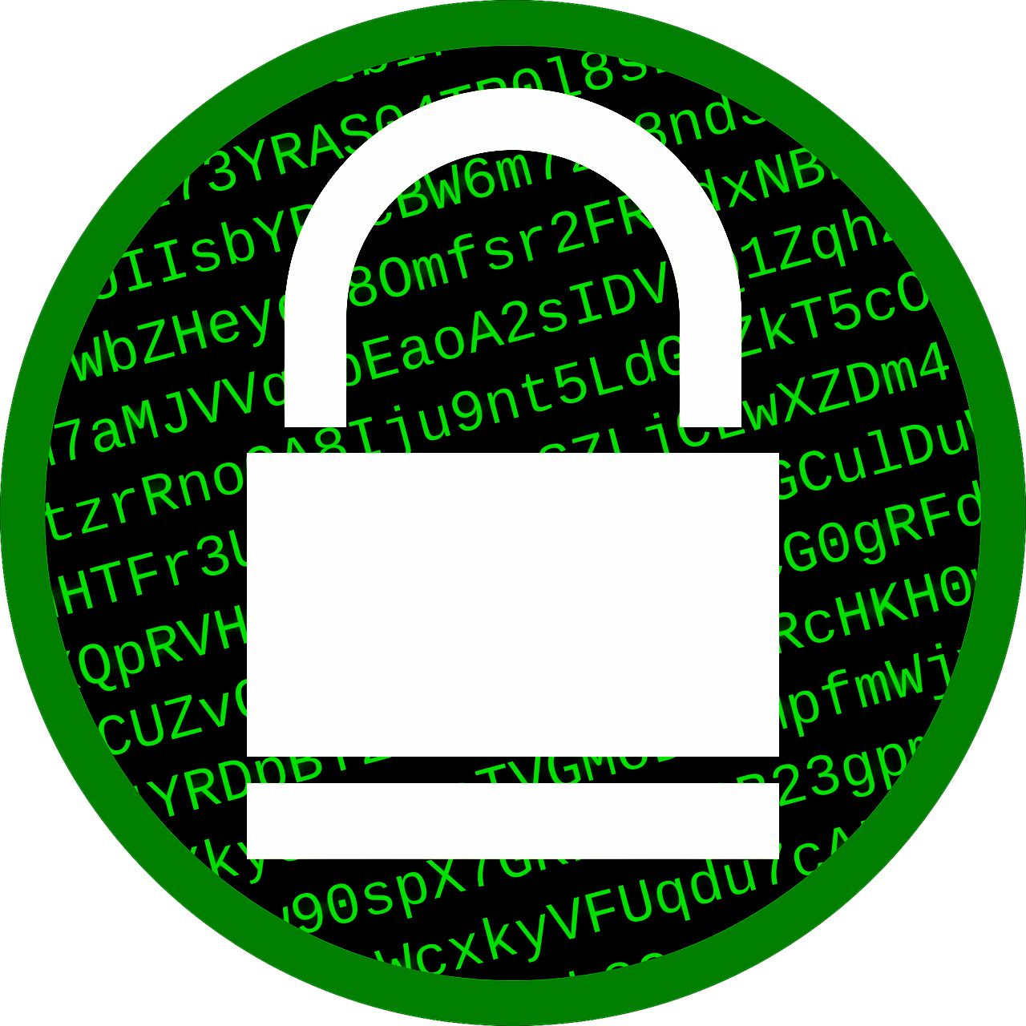


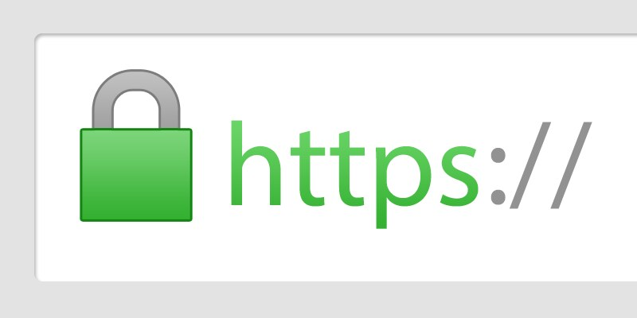
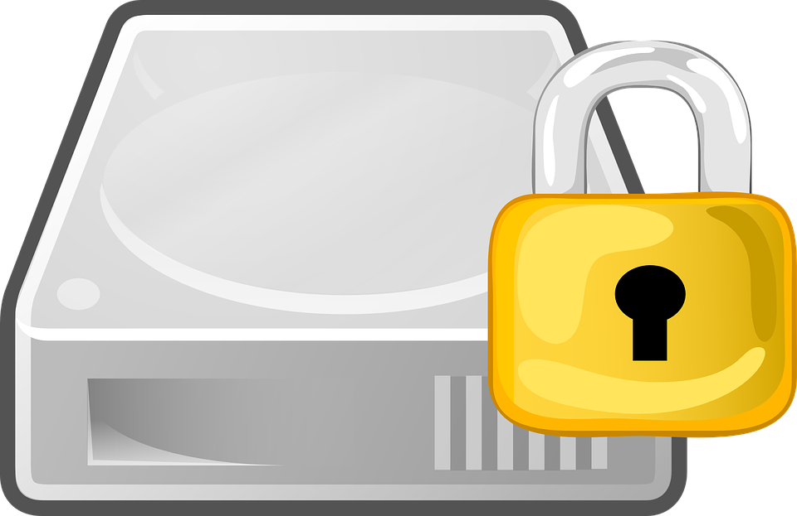
Encryption
Can help protect your data
Can also “help” an attacker, e.g. ransomware
Protecting data sent or received
HTTP vs. HTTPS
Wireless -> WPA2 (AES) recommended
Protecting devices
Helpful if device is lost/stolen
Often associated with phone PIN/passcode
Microsoft Windows - BitLocker
Apple MacOS - FileVault
Notes:
Here’s another topic that eyes often glaze over. Use the HTTP versus HTTPS as an example. Explain how encryption helps protect all of us including shopping on the internet, when using wireless communications, etc. If you have anyone from the medical field in attendance, then I would also point out that lost and stolen devices such as laptops are the #1 reason for patient data breaches of more than 500 records. (Source: https://www.texmed.org/HIPAALostLaptop/)

Slide 49
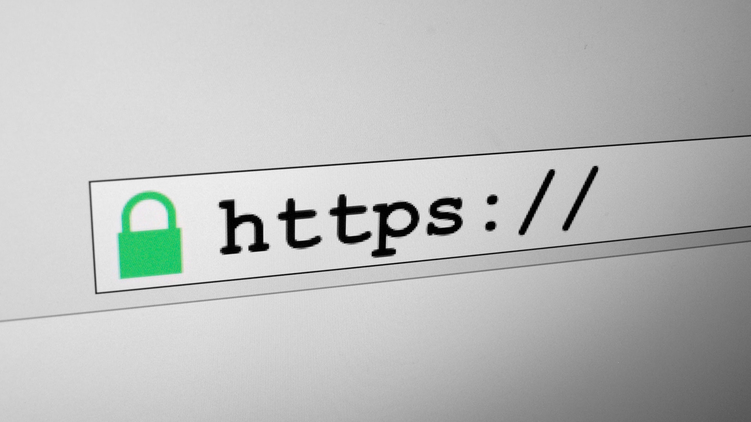
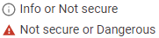
Internet Safety Quick Tips
Never click or install anything based on a pop-up from a website
“Trusted” websites can & have hosted malware, aka malvertising
Local news?
WSJ, Forbes, ESPN, Yahoo, etc.
Limit browsing to business relevant sites?
Avoid public: Wi-Fi, computers (hotels, libraries), charging, etc.
Do NOT assume a site is legitimate simply because of the “padlock”
No more padlock?
Notes:
A few tips that didn’t fit in well elsewhere. Any website can unwillingly be used to distribute malware. We also recommend avoiding public wi-fi and public computers because they are perfect places for attackers to lurk. Also, after discussing HTTP and HTTPS from the previous slide, this is a great opportunity to point out that HTTPS (and the padlock) doesn’t necessarily mean a site is legit. It simply means your communications with that website are encrypted and it is up to the user to make sure they are at the correct site. To make matters more confusing, some browsers are now showing nothing (no padlock even) for secure websites. Instead, they only show “not secure” or something similar if the website is just HTTP, i.e. *not* HTTPS.

Slide 50
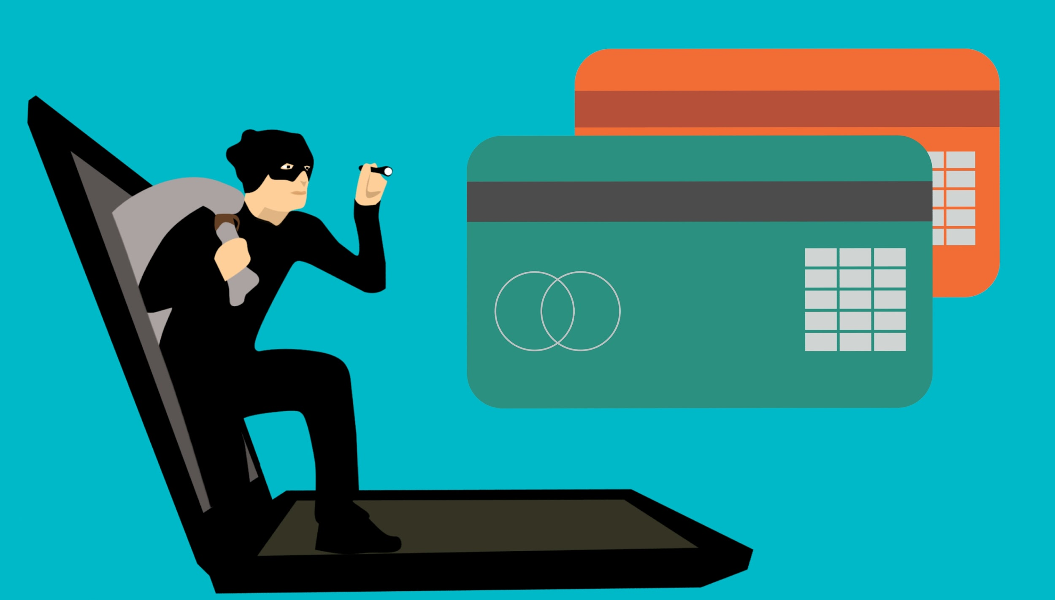
Internet Privacy
Data is the new gold -> your data is valuable!
If you’re not paying for it, are you the product?
Data analytics & predictive results
Examples: advertising & insurance rates
Are you oversharing?
“Fun” online surveys => data harvesting
Default privacy settings on social media
Vacation photos & checking-in (location sharing)
Thieves see that information also
Would you be comfortable telling people on the street?
Notes:
A short discussion on privacy and not oversharing. The “fun” surveys to figure out your IQ, which cartoon character you are most like, etc. are all ways to get access to your social media profile and harvest data from you! Everyone knows someone who posted their vacation pictures while they were on vacation and their house was broken in as a result. I tell people to wait until they come home to post their pictures; that will make the following week of work go faster when they are reminiscing about their recent vacation. ;-)

Slide 51
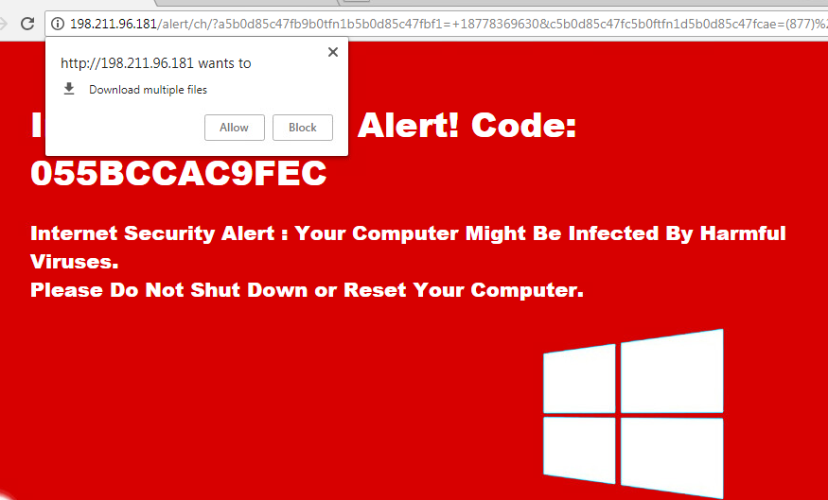


Uh oh! You’ve been scammed
It happens! Don’t be ashamed!
Don’t panic, but don’t wait around
Unplug computer?
Contact your technical support
Write down details - event timeline, financial accounts, credentials used, phone numbers, etc.
Ransomware or scam
Report the incident to law enforcement?
In the US
BBB - https://www.bbb.org/scamtracker
FBI - Ransomware keys may be available
https://www.nomoreransom.org/
Notes:
Last but not least, what do you do when you or a loved one falls victim to a scam. Ask for help! Time is of the essence so act fast! Maybe that includes unplugging the power to your computer or the network cable to avoid the possibility of infecting other machines? Write down any details you think might be helpful such as dates/times, which accounts or credentials might be in question, as well as any other relevant info. If it’s ransomware or a scam, do you report it? Who do you report it to? If it’s ransomware, ransomware keys may be available. The folks at nomoreransom.org have an awesome site that is setup for just that purpose.

Slide 52

More Resources
When in doubt, ask questions
Your IT dept/provider?
Don’t stop here! Attacks change, so should you
Additional Resources
SANS Ouch! - free monthly newsletter
StaySafeOnline.org - numerous free resources
Stop. Think. Connect. - free, little bit of everything
TreeTop Security - Cybersecurity Awareness Training (free) These slides, video presentation of this material, value-add worksheets, post-training quizzes, feedback form, newsletter sign-up, certificate of completion & more! - https://www.treetopsecurity.com/CAT
Worksheet #5 - Sharing is caring
TreeTop?
Notes:
Encourage attendees to ask questions if they are unsure if something is legit. Typically if their gut tells them it’s not quite right, there’s a reason for it! Encourage them to ask someone more tech savvy or if it’s at a business, have them ask their IT department. A 30 second question is far better than weeks (or more) of agony. Encourage the audience to continue learning, i.e. attacks evolve so they should too. The SANS Ouch newsletter is a fantastic, free monthly newsletter that anyone can sign up for; they frequently cover scams in the news as well as ways to protect yourself online and they are aimed at the average user, not IT people. Staysafeonline.org has tons of free resources and DHS has the Stop.Think.Connect. program to help educate business and end users alike.
Finally, our website has these slides and a video of us presenting these slides. There are also worksheets for attendees to take home or back to the office, a feedback form on how we can improve this presentation, a sign-up for our monthly newsletter, along with a cybersecurity quiz to test what users learned. We even have a certificate of completion so they can others (and their boss) that they are more cyber aware!
Finally, encourage attendees to help others in the process by sharing this information/presentation.

Slide 53


Questions?
Your name Your company name & logo
Website address
Phone number
Notes:
My contact info. Place your information here for others to get in contact with you. Remember, you’re the expert!
Don’t forget to recognize the original content was provided free of charge from TreeTop Security.

Slide 54

Questions?
Example
https://www.treetopsecurity.com
Ask about Peak. The affordable, comprehensive, & common sense cybersecurity platform designed for small businesses.
785-370-3444
Dallas Haselhorst
info@treetopsecurity.com
Notes:
My contact info. Place your information here for others to get in contact with you. Remember, you’re the expert!
Don’t forget to recognize the original content was provided free of charge from TreeTop Security.

